Slide 1
Email Classification Using Deep Learning: Spam, Scam, and Safe
~Project by Atharva Sardar

Slide 2
Motivation
Personal experience with job scams revealed weaknesses in spam filters.
OSINT investigation project uncovered evolving scam tactics.
93% of cyberattacks begin with phishing emails (Verizon 2023)
Over 3 billion phishing emails are sent daily, targeting sensitive information.
Need for a combined model for spam, scam, and safe email classification.

Slide 3
Problem Statement
Emails often pose security risks through spam and phishing scams, yet traditional classification models primarily focus on identifying only one category, leaving gaps in comprehensive email security.
This project aims to address this limitation by leveraging deep learning models, including LSTM and BERT, to accurately classify emails into three categories: spam, scam, and safe, enhancing user protection against diverse email threats.
Differentiating between harmless spam and harmful scams.

Slide 4
Spam vs Scam
Spam is generally anything which we are not interested in and even then we receive it.
It generally do not tend to cause any harm
Examples:
Unsolicited Advertising
Unwanted Newsletters
Coupon or Discount Emails
Scams are generally emails which are targeted to a person with a malicious intent of hurting the person
They can cause a lot of damage ranging from financial loss to identity theft.
Examples:
Impersonation Scam
Investment Scam
Lottery or Prize Scam

Slide 5
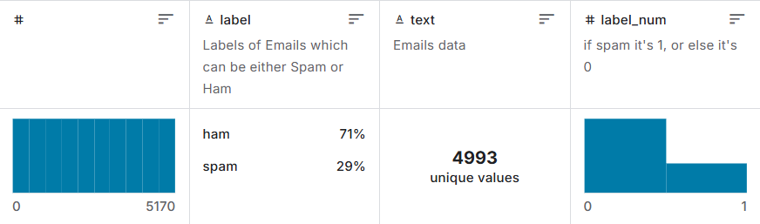
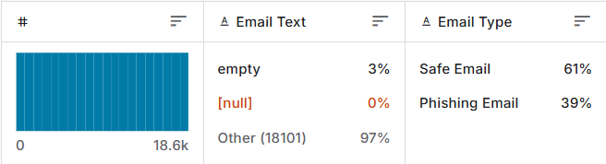
Data Description
Spam Mails Dataset:
This dataset contains emails which are spams
5,170 samples: 71% ham (safe), 29% spam.
Phishing Email Detection Dataset:
This dataset contains emails which are scams
18,650 samples: 61% safe, 39% phishing.

Slide 6
Data Preprocessing
Combining datasets into a unified format.
Standardizing labels: "Spam," "Scam," "Safe Email."
Applied undersampling technique to balance the created dataset.
Data cleaning: removing HTML tags, special characters, and stopwords.
Used nltk to remove stopwords and lammetize words
GloVe Word Embeddings: Downloaded and loaded pre-trained GloVe (Global Vectors for Word Representation) embeddings (100-dimensional). Created an embedding matrix mapping tokens to GloVe vectors for better semantic representation.

Slide 7
Models Applied
LSTM Model:
GloVe Word Embeddings: Pre-trained GloVe embeddings are loaded and used to create an embedding matrix, which is then used to initialize the embedding layer of the model. LSTM
Model Training: The model, consisting of LSTM layers with dropout for regularization, is trained on the processed data, and performance is evaluated using a classification report.
Regularization techniques like dropout are used to prevent overfitting, and the softmax output layer assigns probabilities to each class.
BERT Model:
Data Tokenization: The code tokenizes email texts using BERT tokenizer, ensuring they are padded, truncated, and converted into tensors for model input.
Model Training: The BERT model is fine-tuned with specified training arguments, and the Trainer class is used for training and evaluating the model on the email classification task.
BERT-LSTM Hybrid:
Custom Model with BERT and LSTM: The model combines BERT for contextual embedding with an LSTM layer to capture sequential dependencies, followed by a classifier for multi-class classification.
Training & Evaluation: A custom Trainer is used to train and evaluate the model, with customized loss computation and specified training arguments.
Notes:
Embedding Layer: Uses pre-trained GloVe word embeddings to convert text into dense vectors, with weights frozen during training.
LSTM Layers: Two LSTM layers capture sequential patterns in the text, with dropout and recurrent dropout for regularization.
Output Layer: A dense layer with softmax activation predicts probabilities for three output classes (e.g., email types).

Slide 8
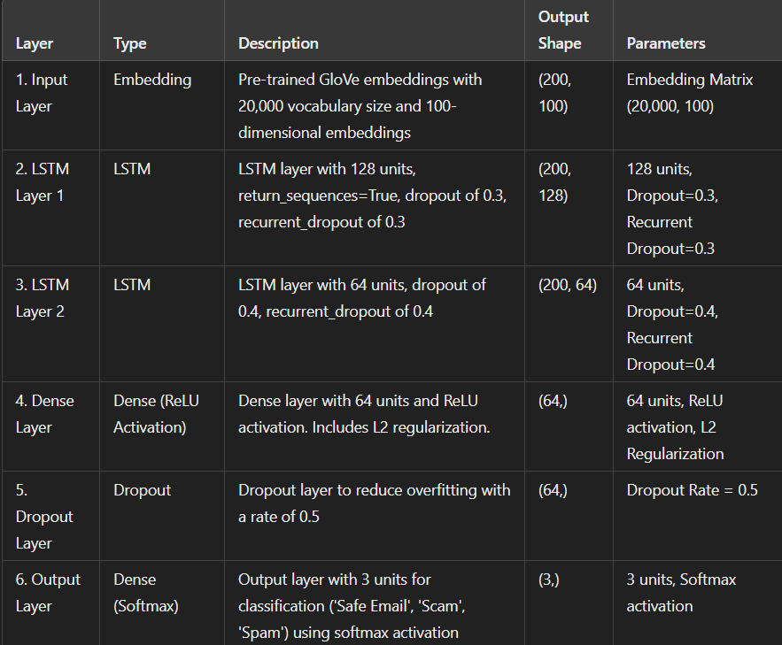
LSTM Model

Slide 9
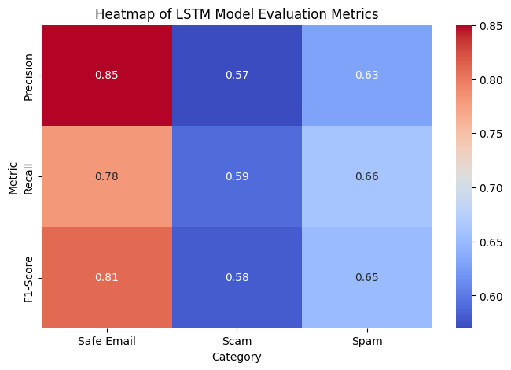
LSTM Results
LSTM: Moderate performance (Accuracy: 68%).

Slide 10
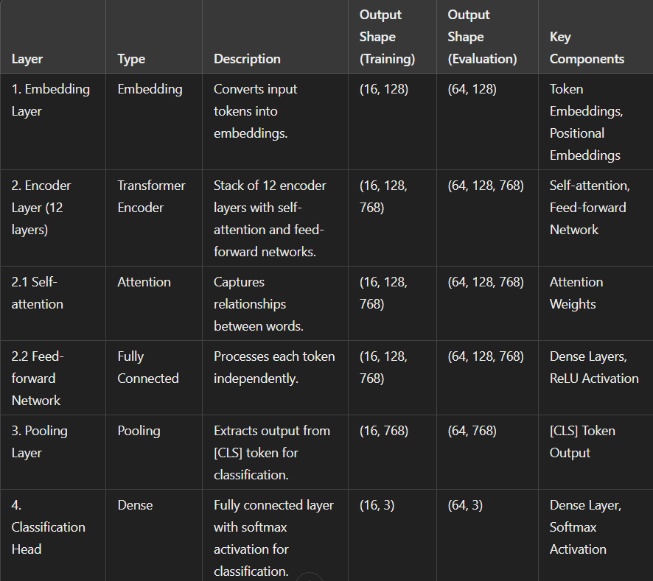
BERT Model

Slide 11
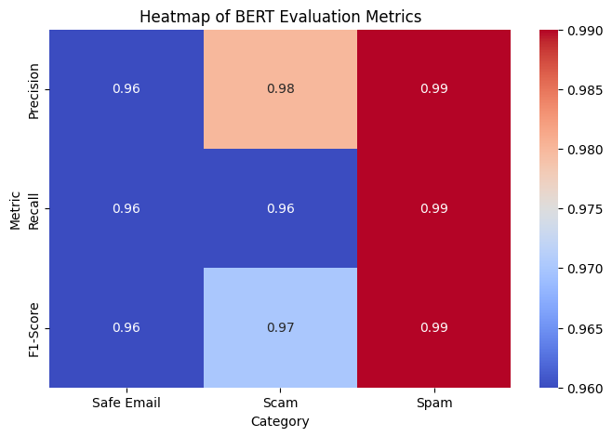
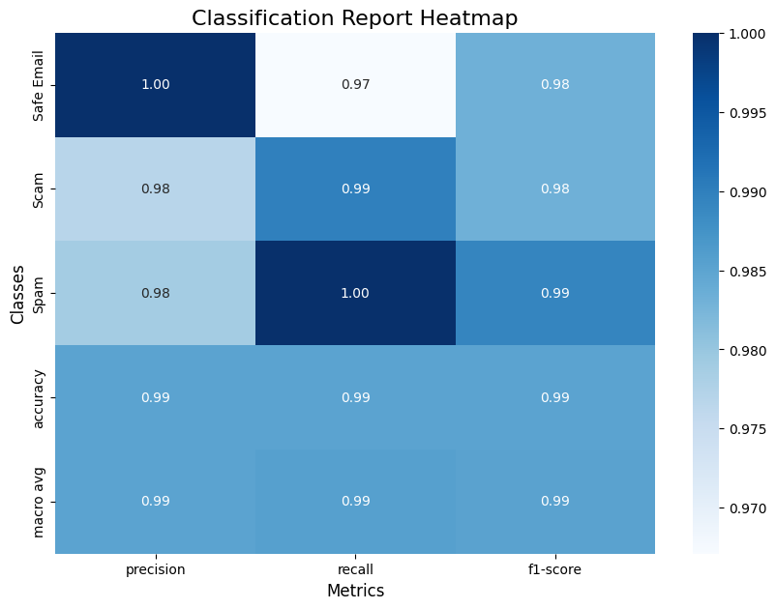
BERT Results
Loss: 0.112998
Loss: 0.09825

Slide 12
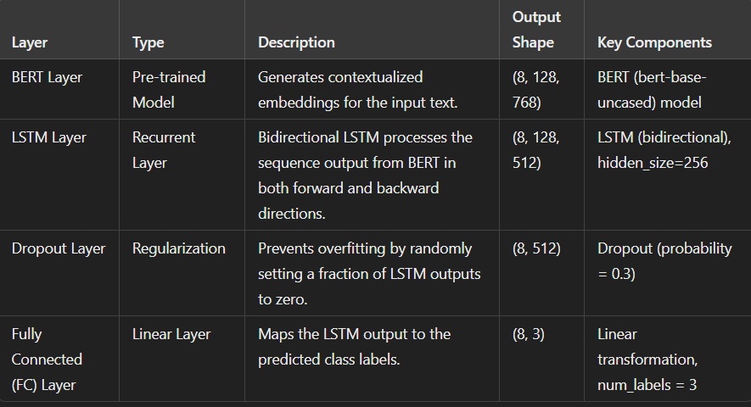
Bert_LSTM Combination Model

Slide 13
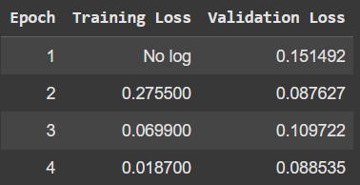
BERT_LSTM combined Model
Loss = 0.088535
This indicates that the hybrid BERT-LSTM model performs well, with a relatively low error rate during validation.

Slide 14
Lessons Learned
Importance of dataset balance for unbiased results.
Limitations of computational resources and strategies to optimize.
Insights into combining models for improved results.
Challenges with real-world data variability.

Slide 15
Broader Impacts
Enhanced email security reduces phishing and data breaches.
Protects individuals and organizations from scams.
Benefits smaller businesses lacking advanced email filtering tools.
Contributes to a safer digital environment.

Slide 16
Future Work
Deploying models for real-time email filtering.
Expanding datasets for better generalization.
Exploring the latest Chatbots for the email classification.

Slide 17
Acknowledgments
Thank you Professor Chandan Reddy for guidance.
Also thank you to virginia tech for providing the course.

Slide 18
Conclusion
Achieved accurate email classification through advanced NLP models.
Applied BERT-LSTM hybrid model.
Got a loss as low as 0.088535
Room for improvement with the dataset to be used.

